Slide 1
Functions, Modules and Variable Scope
Aayush Man Singh

Slide 2
Function
Functions are blocks of code that perform specific tasks and can be reused.
Parameters, arguments, and keyword arguments are essential concepts in function definition and invocation.

Slide 3

Function
A function is defined using the def keyword followed by the function name and parentheses.
It may have parameters, which are placeholders for values passed to the function.
The code inside the function is executed when the function is called.

Slide 4
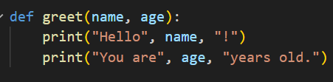
Parameters
Parameters are defined inside the parentheses of a function's definition.
They represent the values that need to be passed to the function.
Parameters act as local variables within the function's scope.

Slide 5
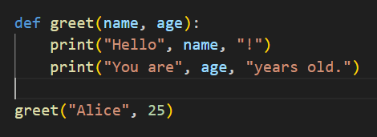
Positional Arguments
Arguments are the actual values passed to a function when it is called.
They correspond to the parameters defined in the function's definition.
The number and order of arguments must match the function's parameters.

Slide 6
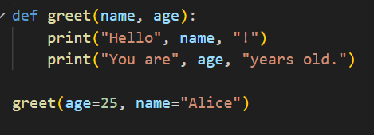
Keyword arguments
Keyword arguments are passed using parameter names.
The argument is assigned to the parameter with the matching name.
They allow you to pass arguments in any order.

Slide 7
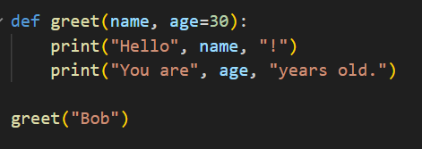
Default Parameters
Parameters can have default values assigned to them.
If an argument is not provided for a parameter, the default value is used.
Default parameters must come after non-default parameters.

Slide 8
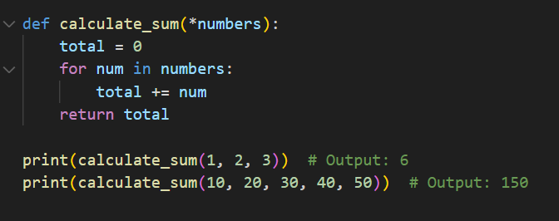
Arbitrary arguments
Python allows us to define functions with flexible argument handling using arbitrary arguments and keyword arguments.
Arbitrary arguments allow functions to accept a varying number of positional arguments, while keyword arguments provide flexibility with named arguments.
Arbitrary arguments collect variable number of positional arguments into a tuple named args.
Allows passing any number of arguments to the function.
Iteration or indexing can be used to process the arguments.

Slide 9
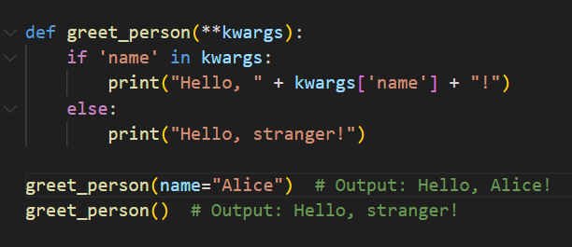
Arbitrary keyword arguments
Keyword arguments collect variable number of named arguments into a dictionary named kwargs.
Allows passing arguments with their names to the function.
Enables more explicit and readable function calls.

Slide 10
Parameters and Arguments Summary
Functions allow for code reuse and perform specific tasks.
Parameters are defined in the function's definition and represent values passed to the function.
Arguments are the actual values passed to the function when it is called.
Positional arguments are passed based on their order.
Keyword arguments are passed using parameter names and can be provided in any order.
Default parameters have default values assigned to them.

Slide 11
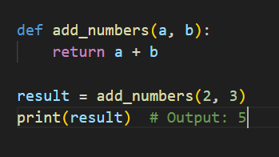
The return statement
The return statement in Python functions is used to specify the value that a function should return after its execution.
It allows functions to provide output and communicate results to the caller.
The return statement is used to explicitly specify the value to be returned.
It can be used anywhere within a function, even multiple times.

Slide 12
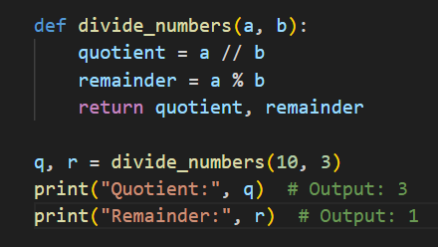
Returning multiple values
Python functions can return multiple values using tuples.
Multiple values can be unpacked into separate variables upon function invocation.

Slide 13
Returning None
If a return statement is omitted or empty, the function returns None by default.
None represents the absence of a value and is often used to indicate no specific result.

Slide 14
Variable scope
Variable scope determines where variables can be accessed and modified in a program.
Understanding variable scope is crucial for writing robust and error-free code in Python.

Slide 15
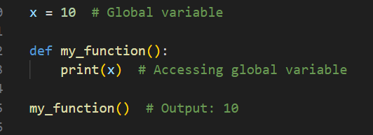
Global Scope
Variables defined outside any function or class have global scope.
Global variables can be accessed and modified from anywhere in the program.
They persist throughout the program's execution.

Slide 16
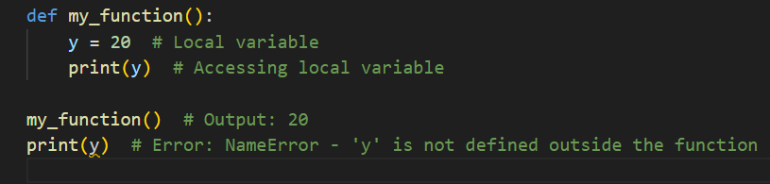
Local Scope
Variables defined inside a function or class have local scope.
Local variables can only be accessed within the function or class they are defined in.
They are destroyed when the function or class finishes execution.

Slide 17
Modules
The import statement is used to access modules and their functionalities in Python.
Modules are files containing Python code for reuse in other programs.
Specific functions can be imported from a module or imported with an alias.
Custom modules can be created by writing Python code in separate files.

Slide 18
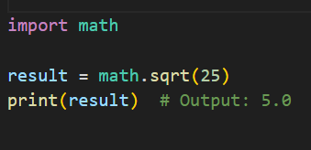
To import a module, use the import statement followed by the module name.
The module name can be either a standard library module or a user-defined module.
To access functions or variables defined in a module, use the module name followed by a dot (.) and the function/variable name.

Slide 19
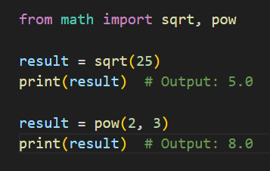
If you only need specific functions from a module, you can import them directly.

Slide 20
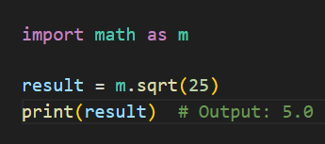
You can assign an alias to a module or a specific function to simplify its usage.

